Slide 1

Thesis
Loan risk assessment from Greek legal reports
Georgios Kekkis
F3352021
Academic supervisor: Prodromos Malakasiotis
NBG supervisor: Nikolaos Bogdos
Athens, November 2021

Slide 2
Topic

Slide 3


Topic
Business Experience
Purpose of Loan
Bank requirements
Credit History
A Personal Guarantee
Business Plan
Loan request
Response

Slide 4
Topic
Associated departments
Legal Department
Department of Economics
Final decision
Department of Operations
Department of Loans

Slide 5
Topic
Associated departments
Legal Department
Final decision
In this work we cooperated with the Legal Department

Slide 6
Topic
The Legal Department assign each company into one of the following risk categories
Low risk
Intermediate risk
High risk
Loan request
Response

Slide 7
Topic
Recommendation
Lawyer
Model
Evaluation
Lawyer
Model
Substitution
Model

Slide 8
Dataset

Slide 9
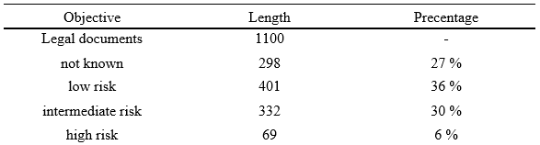
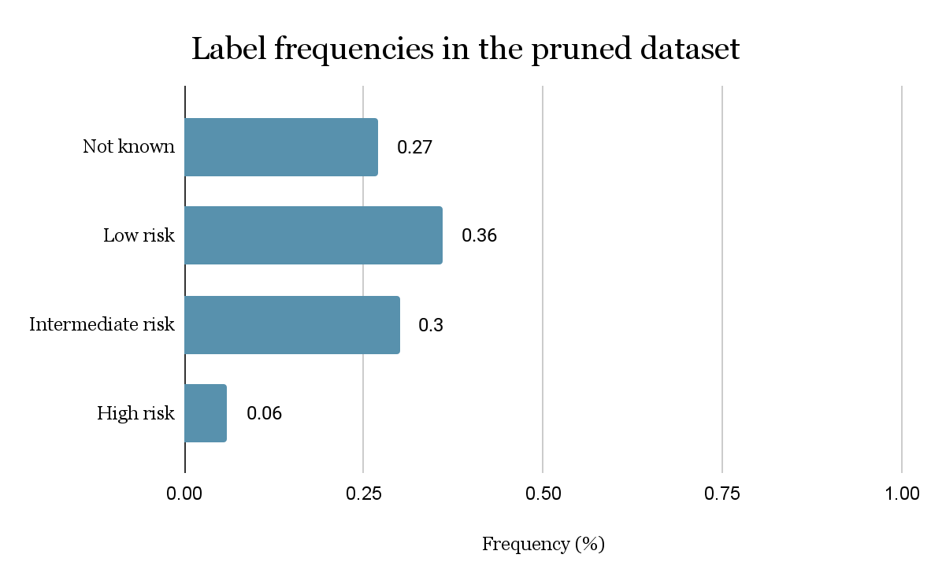

Dataset

Slide 10
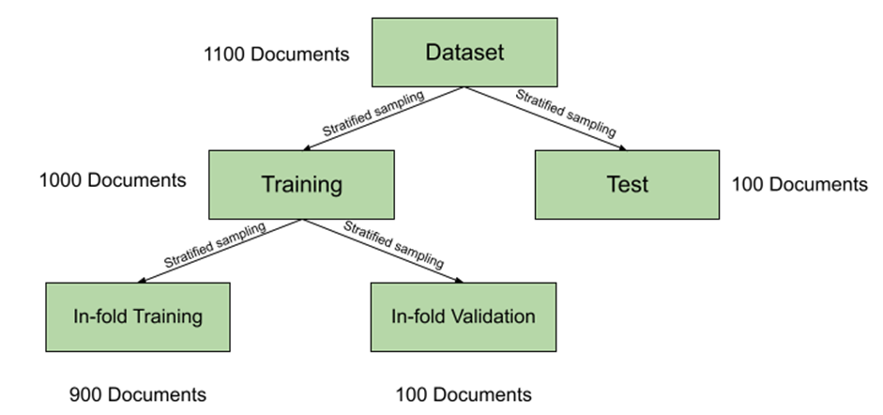
10-fold Cross Validation with Stratified Sampling

Slide 11
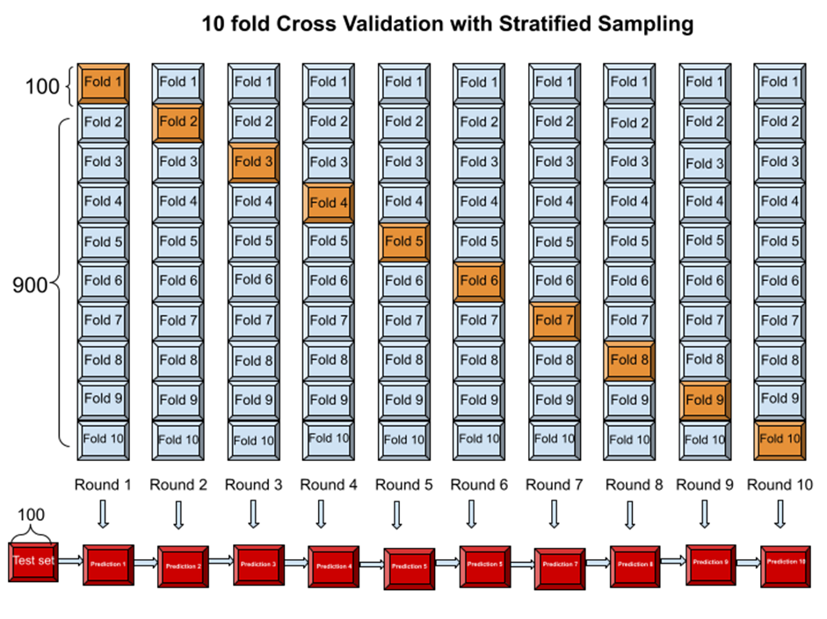
10-fold Cross Validation with Stratified Sampling
In each round we apply stratified sampling to form the validations sets
We keep the model’s predictions on the validation and test sets
The final predictions on the test set are formed by taking the simple or the weighted average of the predictions of each fold

Slide 12
Methodology

Slide 13

Methodology
προς
x₁
την
x₂
εθνικη
x₃
τραπεζα
x₄
Embeddings
Encoder
Legal report
Regressor
της
x₅
ελλαδος
x₆
...
...
κινδυνου
x_{max length}

Slide 14
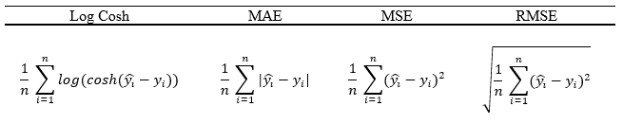
Methodology
Regression Metrics

Slide 15
Methodology
Final estimations
Simple Average
Weighted Average
Every estimation from the 10-fold Cross Validation has the same weight
Every estimation from the 10-fold Cross Validation has different weight depending on its MAE scores on the validation sets

Slide 16

Methodology
Bi-LSTM with Attention
Deep Pyramid CNN with pre-activation
Dilated CNNs
Deep Inception Pyramid
Deep Inception Pyramid + Bi-LSTM + Attention
Greek-BERT

Slide 17
Deep Inception Pyramid

Slide 18
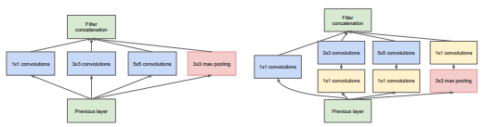
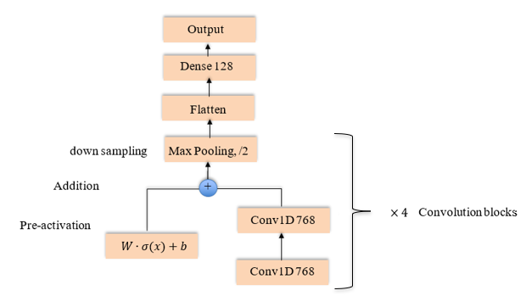
Deep Inception Pyramid
The goal was to find an optimal combination of Inception and Pyramid models
An optimal combination would increase our model’s receptive field, thus catch long-term dependencies, and keep the computational complexity at a feasible level
Inception model architecture, image from Zhao, B., et al., 2017
Deep Pyramid CNN architecture, image from Johnson, R., & Zhang, T., 2017

Slide 19
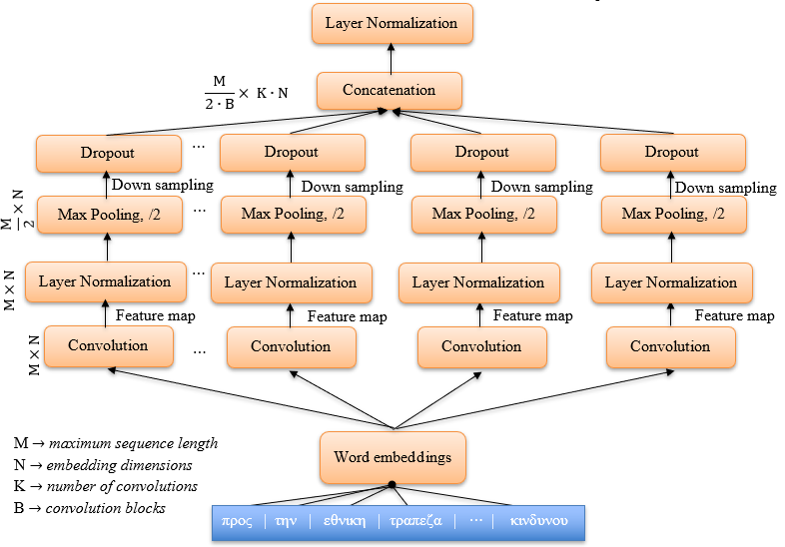
Deep Inception Pyramid
Parallel convolutions with different n-grams and dilation rates extract different feature maps
Each convolution pass its feature map to a Max Pooling layer with stride 2
Then the extracted feature maps (local contextualized embeddings) are combined into the concatenation matrix
Then the final regressor takes as input the normalized hypertoken matrix to form the final risk estimation
Inception block

Slide 20
Deep Inception Pyramid
The concatenation matrix contains hypertokens of local contextualized embeddings
Each hypertoken representation is derived from different token neighbourhoods
As we increase the number of Inception blocks, every new hypertoken represents a wider and more abstract token neighbourhood
Inception block

Slide 21
Deep Inception Pyramid
Inception block
Hyperparameter | Value
Optimizer | Adam
Learning rate | 1e-3
Convolution filters | Embedding size
Dropout | 0.3
Regressor dropout | 0.3
Dense 1 neurons | 64
Dense 2 neurons | 32
Inception blocks | 1
Pooling size | 3
Global Average Pooling
Dropout
Dense
Dense
Output
Estimated risk

Slide 22
Deep Inception Pyramid + Bi-LSTM + Attention

Slide 23
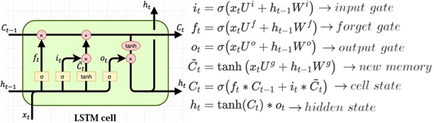
Deep Inception Pyramid + Bi-LSTM + Attention
The idea here was to put a state of the art sequence model on top of the Inception block
Consequently, the Bi-LSTM model with Attention was the best choice as we will see later
Inception model architecture, image from Zhao, B., et al., 2017
LSTM gate, image from Varsamopoulos, S., et al., 2019

Slide 24
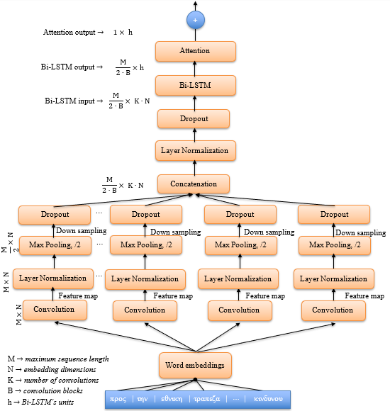
Deep Inception Pyramid + Bi-LSTM + Attention
Concatenation matrix contains local contextualized embeddings derived from 4 different convolutions
Bi-LSTM takes as input the normalized concatenation matrix, thus a different document representation
This representation is still consisted of sequences of words, which are hypertokens
Inception block + Bi-LSTM + Attention

Slide 25
Deep Inception Pyramid + Bi-LSTM + Attention
The Bi-LSTM output goes to the Attention layer which creates a weighted vector with the most significant hypertoken ‘signals’
Here, Attention plays the role of Global Average Pooling of the previous Inception architecture
The weighted vector then is passed to the final regressor
Inception block + Bi-LSTM + Attention

Slide 26
Deep Inception Pyramid + Bi-LSTM + Attention
Inception block
Hyperparameter | Value
Optimizer | Adam
Learning rate | 1e-3
Convolution filters | Embedding size
Dropouts | 0.2
Regressor dropout | 0.3
Dense 1 neurons | 128
Dense 2 neurons | 64
Convolution blocks | 1
Pooling size | 3
Bi-LSTMs | 1
Internal Bi-LSTM dropout | 0.2
Dropout
Bi-LSTM
Attention
Dense
Dense
Dense
Output
Estimated risk

Slide 27
Experimental results

Slide 28
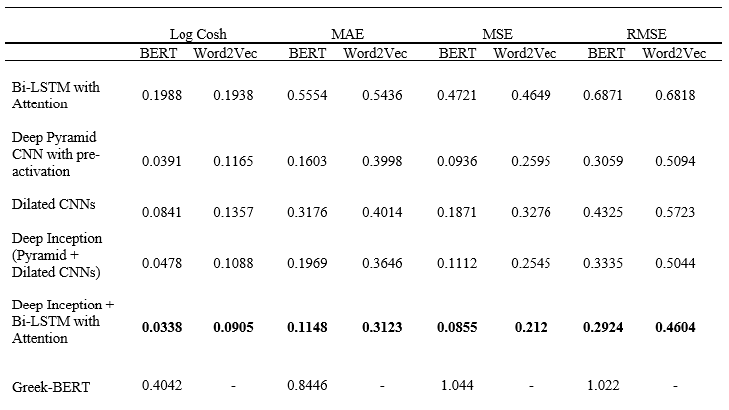
Experimental results - Weighted Average

Slide 29
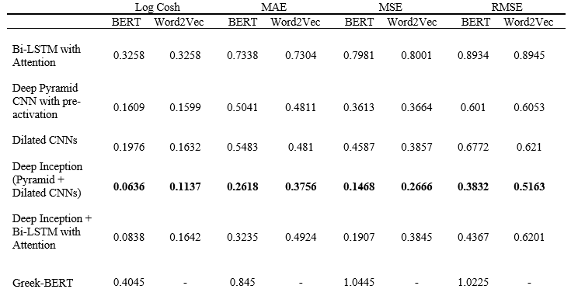
Experimental results - Simple Average

Slide 30
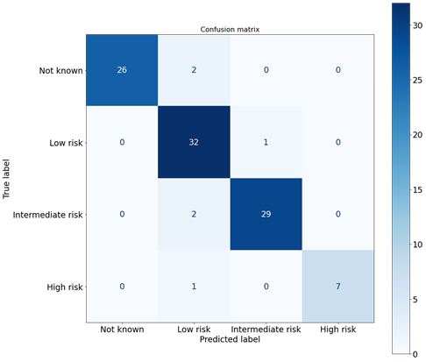
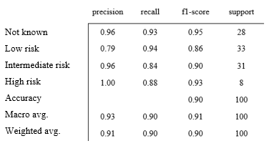
Experimental results
Deep Inception + Bi-LSTM with Attention

Slide 31
Pruned dataset

Slide 32
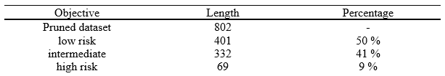
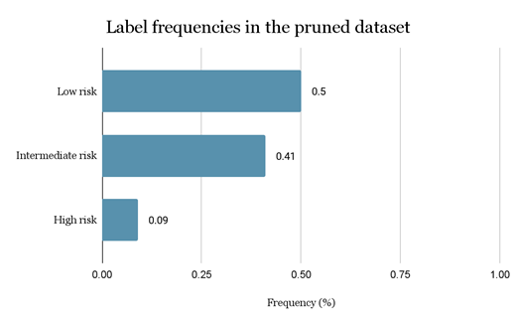
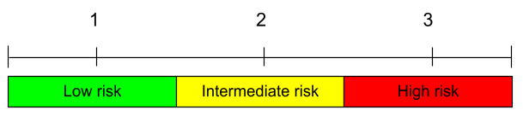
Pruned dataset

Slide 33
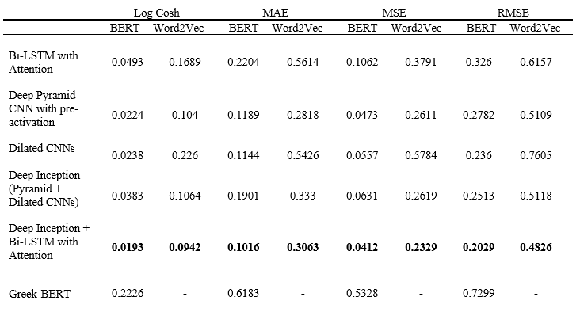
Experimental results - Weighted Average

Slide 34
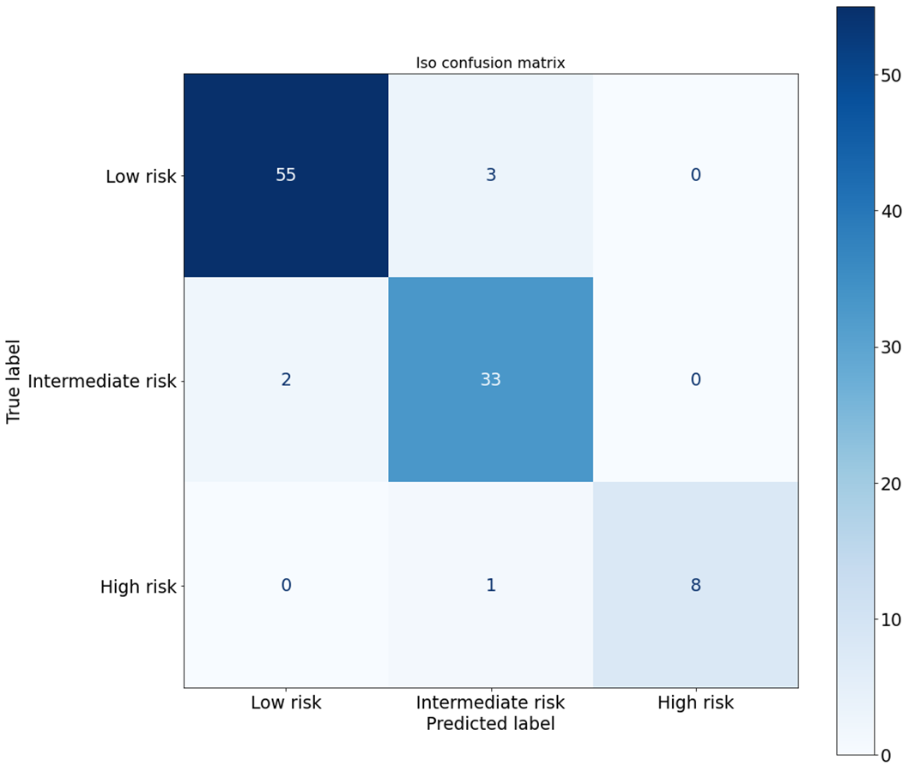
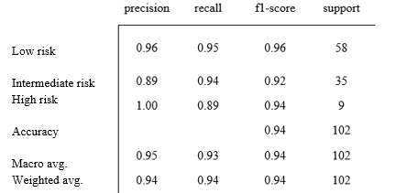
Experimental results
Deep Inception (Pyramid + Dilated CNN)

Slide 35
Prediction
Gold
Experimental results - Inception + Bi-LSTM with Attention
Prediction: 1.004
Gold: 1
Prediction: 1.8958
Gold: 2
Prediction: 2.4809
Gold: 3
Prediction: 1.095
Gold: 1
Prediction: 2.0248
Gold: 2
Prediction: 2.9685
Gold: 3

Slide 36
Conclusions and future work

Slide 37
Conclusions and future work
The experimental results had shown that parallel convolutions combined with Bi-LSTM and Attention were the most suitable option for this task
This thesis indicates that Inception models could be applied and outperform existing models in NLP tasks
Greek Legal BERT embeddings may be proven very useful in this kind of tasks
Inception Bi-LSTM with Attention could be used as a recommendation and evaluation system

Slide 38
Appendix

Slide 39
Dataset and Pre-processing
Embedding types
Greek-BERT
Word2Vec
|V| = 39214 embedding dimensions = 300
Parameter | Value
Embedding dimensions | 300
Window | 5
Minimum count | 10
Workers | 5
Maximum vocabulary size | 100 K
|V| = 35K embedding dimensions = 768
Wikipedia | 131,991 documents
European Proceedings | 1,517,141 sentences
OSCAR | 2,412,419,435 words
Wikipedia | 131,991 documents
European Parliament Proceedings | 1,517,141 sentences

Slide 40
Dataset and Pre-processing - BERT embeddings
Embedding types
Greek-BERT
Word2Vec
Token minimum frequency: 10
Token maximum frequency:
Maximum document length:
Token minimum frequency: 10
Token maximum frequency:
Maximum document length:

Slide 41
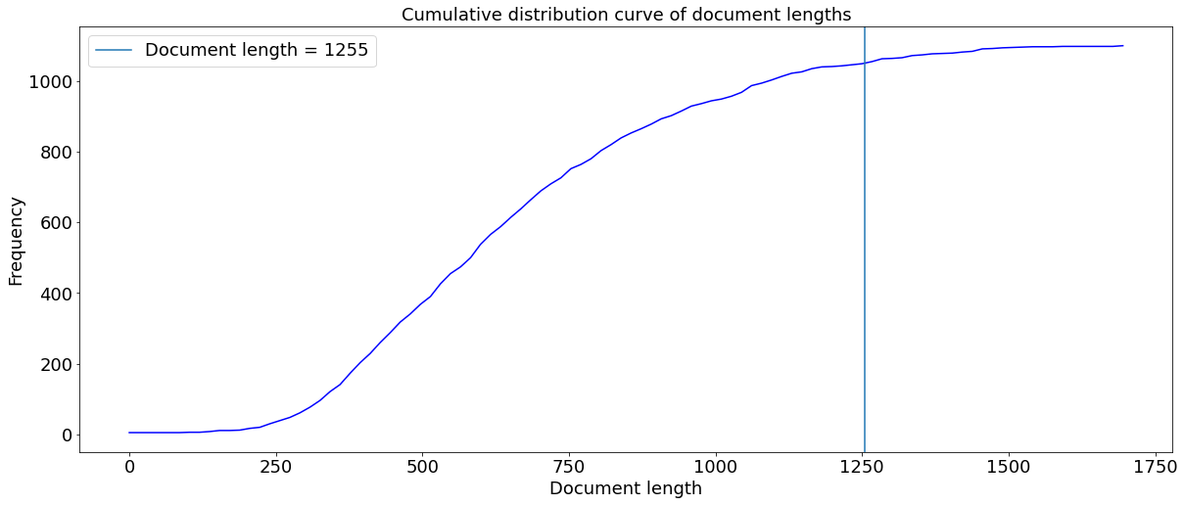
Dataset and Pre-processing - BERT embeddings

Slide 42
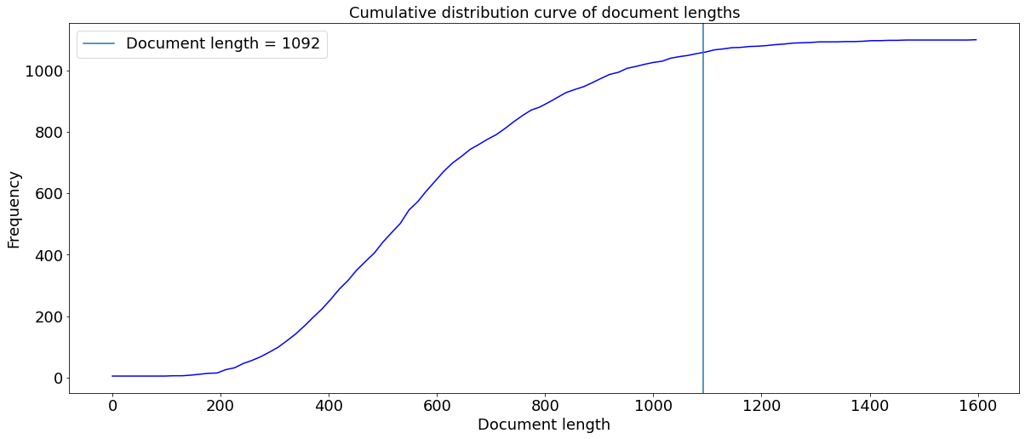
Dataset and Pre-processing - Word2Vec embeddings

Slide 43
Bi-LSTM with Attention

Slide 44
Bi-LSTM with Attention
Documents are long sequences of words
They contain long and short term dependencies
Traditional Vanilla RNNs were not suitable in this case because the gradient of the loss function decays exponentially with time
Nevertheless LSTM gating mechanism could solve this problem
LSTM gate, image from Varsamopoulos, S., et al., 2019

Slide 45
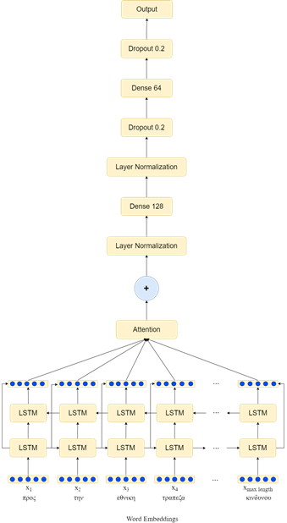
Bi-LSTM with Attention
Hyperparameter | Value
Optimizer | Adam
Learning rate | 1e-3
Bi-LSTMs | 1
Bi-LSTMs internal dropout rate | 0.2
Dense 1 neurons | 128 neurons
Dropout 1 | 0.2
Dense 2 neurons | 64 neurons
Dropout 2 | 0.2

Slide 46
Deep Pyramid CNN with pre-activation

Slide 47

Deep Pyramid CNN with pre-activation
Deep Pyramid CNN (Johnson, R., & Zhang, T., 2017) architecture keeps computational consumption at almost constant levels
The activation function is applied before weighting instead of after
Deep Pyramid CNN architecture, image from Johnson, R., & Zhang, T., 2017

Slide 48
Deep Pyramid CNN with pre-activation
Hyperparameter | Value
Optimizer | Adam
Learning rate | 5e-5
Convolution blocks | 4
Number of filters | Embedding dimensions
Kernel size | 3
Pooling size | 3
Dense neurons | 128

Slide 49
Dilated CNNs

Slide 50
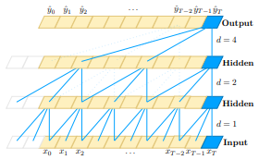
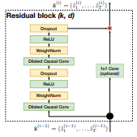
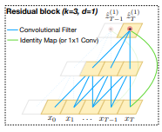
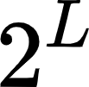
Dilated CNNs
Dilated CNN architecture (Bai, S., et al., 2018) consists of convolutions with dilation rate and residual blocks
In this way, the model’s receptive field increases exponentially with a rate of where L is the number of block
Dilated CNNs, images from Bai, S., et al., 2018

Slide 51
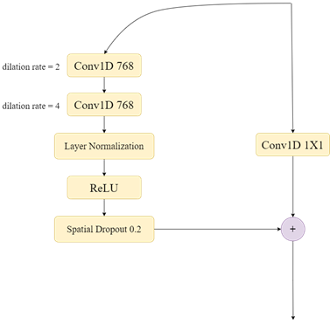

Dilated CNNs
Hyperparameter | Value
Optimizer | Adam
Learning rate | 9e-5
Convolution filters | 768
Kernel sizes | 3
Dilation rate, initial Convolutions | 2
Dilation rate, second Convolutions | 4
Spatial dropout rate | 0.2
After Global Average Pooling Dropout rate | 0.3
Dense 1 neurons | 128
Dense 2 neurons | 64

Slide 52
Greek-BERT

Slide 53
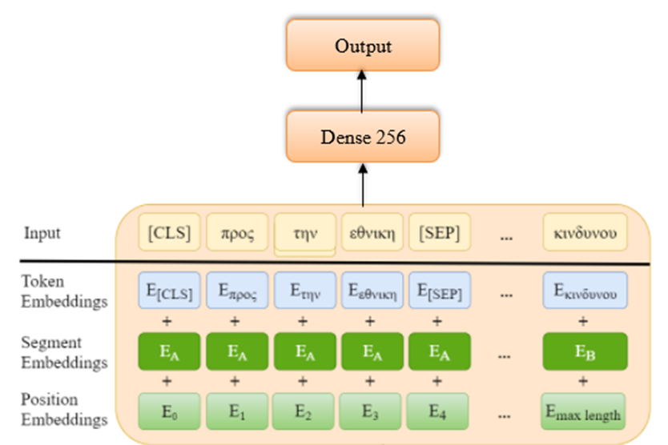
Greek-BERT
Here we used a well-known pre-trained model, the Greek-BERT (Koutsikakis, J., et al., 2020).
Greek BERT is a Greek edition of Google’s BERT language model (Devlin, J., et al, 2018).
For our task, we kept its trainable parameters ‘frozen’ and we only trained the final regressor on top of it.
Greek-BERT architecture (Image inspired from Koutsikakis, J., et al., 2020)

Slide 54
Greek-BERT
Hyperparameter | Value
Optimizer | Adam
Learning rate | 3e-5
Dense 1 neurons | 64
Dropout rate | 0.3
Dense 2 neurons | 32
Greek-BERT architecture (Image inspired from Koutsikakis, J., et al., 2020)

Slide 55
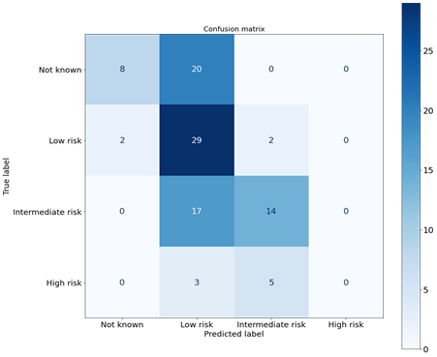
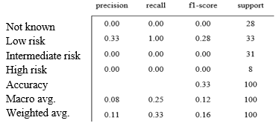
Experimental results
Bi-LSTM with Attention

Slide 56
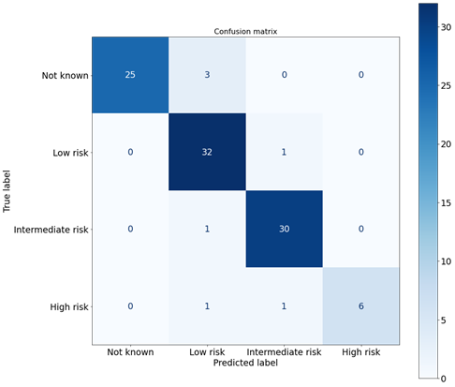
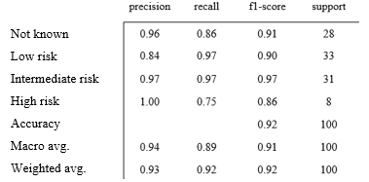
Experimental results
Deep Pyramid CNN with pre-activation

Slide 57
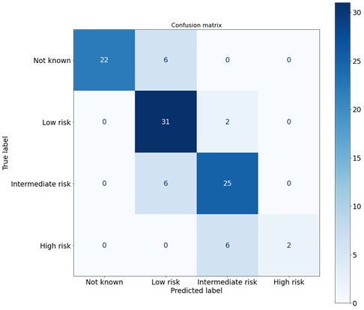
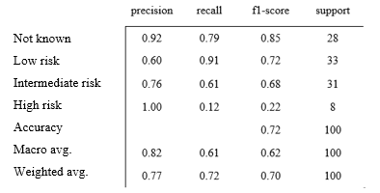
Experimental results
Dilated CNN

Slide 58
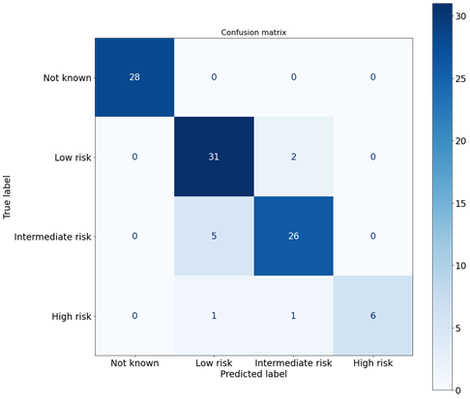
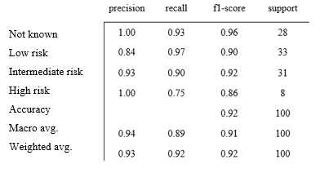
Experimental results
Deep Inception (Pyramid + Dilated CNN)

Slide 59
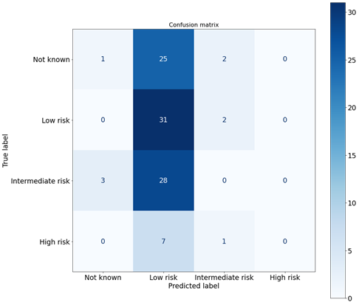
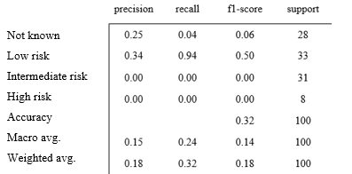
Experimental results
Greek-BERT

Slide 60
Pruned dataset

Slide 61
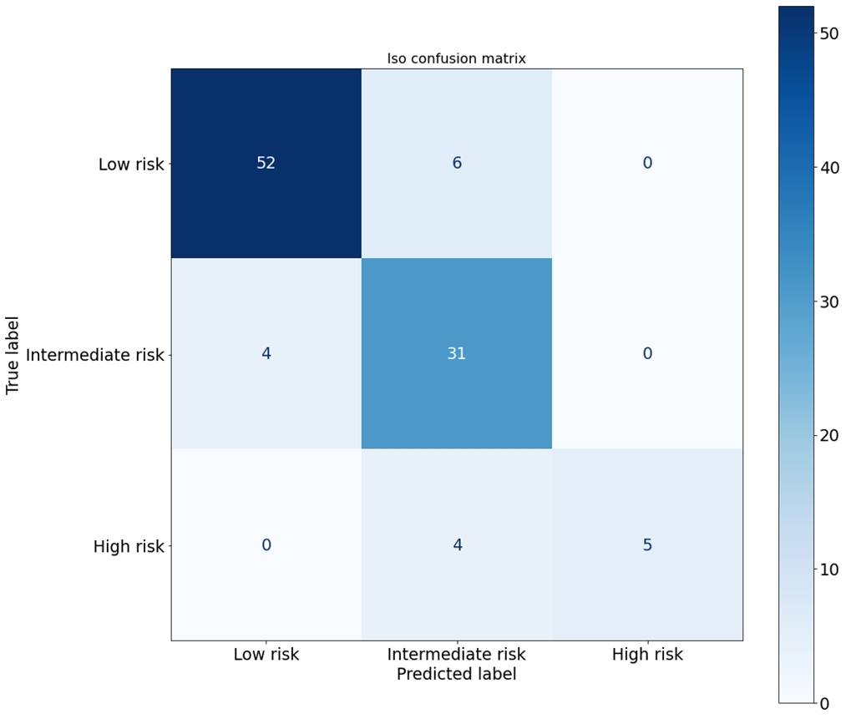
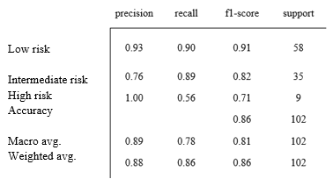
Experimental results
Bi-LSTM with Attention

Slide 62
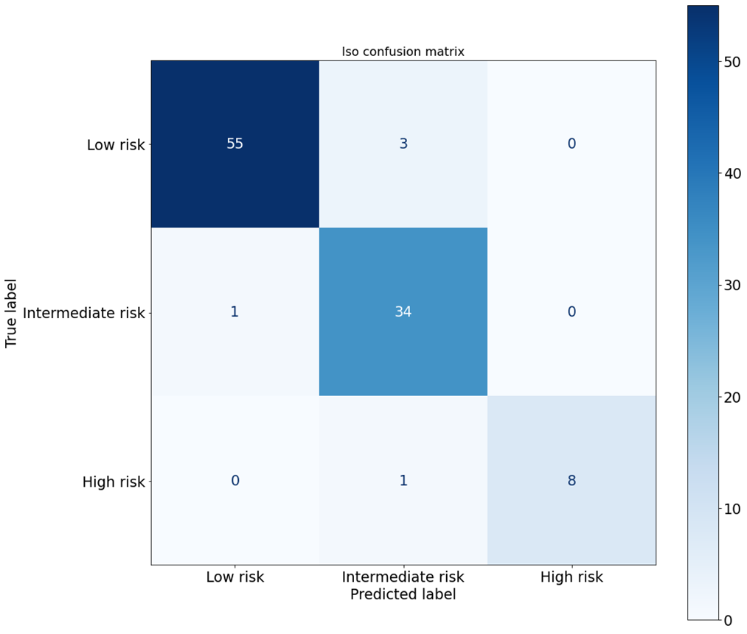
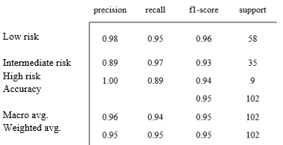
Experimental results
Deep Pyramid CNN with pre-activation

Slide 63

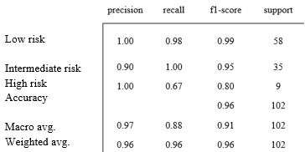
Experimental results
Dilated CNN

Slide 64

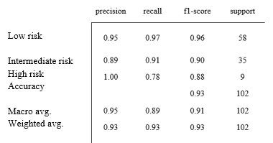
Experimental results
Deep Inception + Bi-LSTM with Attention

Slide 65
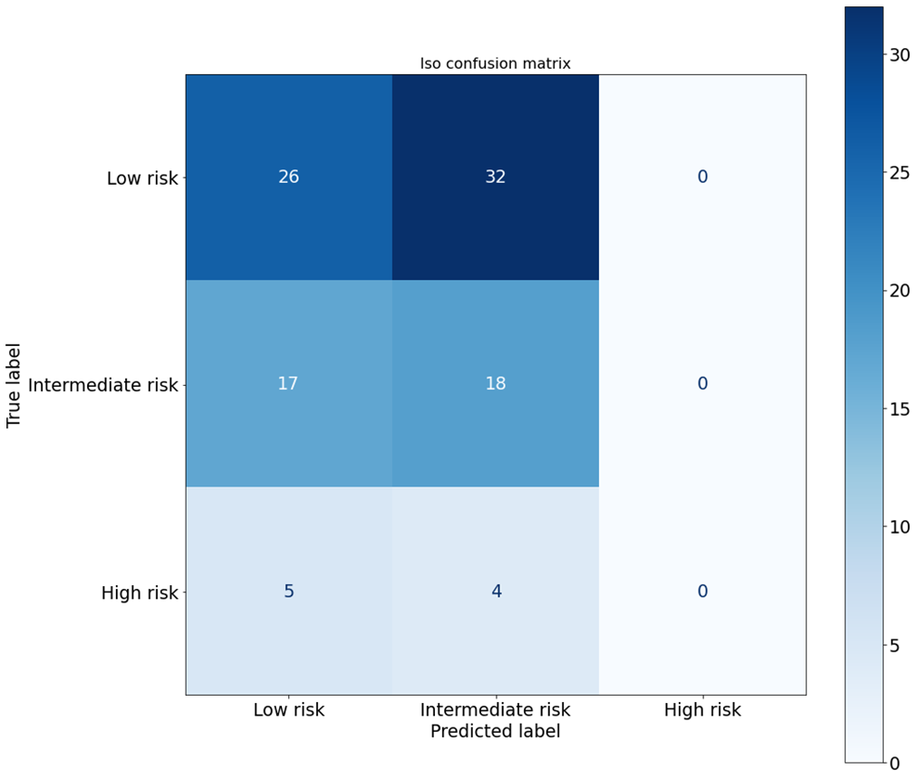
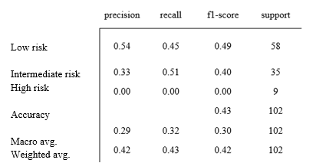
Experimental results
Greek-BERT

Slide 66
References
Koutsikakis, J., Chalkidis, I., Malakasiotis, P., & Androutsopoulos, I. (2020, September). Greek-bert: The Greeks visiting Sesame Street. In 11th Hellenic Conference on Artificial Intelligence (pp. 110-117)
Varsamopoulos, S., Bertels, K., & Almudever, C. G. (2019). Comparing neural network-based decoders for the surface code. IEEE Transactions on Computers, 69(2), 300-311
Bai, S., Kolter, J. Z., & Koltun, V. (2018). An empirical evaluation of generic convolutional and recurrent networks for sequence modelling. arXiv preprint arXiv:1803.01271
Devlin, J., Chang, M. W., Lee, K., & Toutanova, K. (2018). Bert: Pre-training of deep bidirectional transformers for language understanding. arXiv preprint arXiv:1810.04805
Johnson, R., & Zhang, T. (2017, July). Deep pyramid convolutional neural networks for text categorization. In Proceedings of the 55th Annual Meeting of the Association for Computational Linguistics (Volume 1: Long Papers) (pp. 562-570)
S. Hochreiter and J. Schmidhuber. Long short-term memory. Neural Computations, 9(8): 1735–1780, 1997

Slide 67
References
Szegedy, C., Vanhoucke, V., Ioffe, S., Shlens, J., & Wojna, Z. (2016). Rethinking the inception architecture for computer vision. In Proceedings of the IEEE conference on computer vision and pattern recognition (pp. 2818-2826)

